Slide 1
Integrating Sentiment Analysis and Machine Learning for Robust Stock Price Prediction: A Comprehensive Study
Exploring the Synergy of Sentiment Data and Historical Stock Prices for Accurate and Reliable Market Predictions
Name: Anup Wilson
Student Number: 10628141
Date: 8th January 2023

Slide 2
Agenda
01
02
Introduction
Methodology Overview
03
04
Migration, Data Processing and Feature Selection
Sentiment Analysis
05
06
Conclusion
Model Building with and Without Cross Validation

Slide 3
INTRODUCTION
Overview
Investigating the use of sentiment analysis from twitter data and Historical Stock data to predict the stock price for leading EV Companies like Tesla, Ford, Nio, Xpeng.
Need for sentimental analysis for stock price predictions
The study integrates Twitter sentiment analysis into stock price prediction models to understand investor sentiment in the electric car sector, bridging the knowledge gap between social media and traditional financial evaluation methods.
Scope
The study investigates how sentiment analysis could help predict stock prices more effectively, especially in the uncertain EV market. It underlines the importance of sentiment monitoring in financial analysis, suggesting that it could improve overall stock market performance and lead strategic investment decisions.

Slide 4
METHODOLOGY (Crisp-DM)
1
2
3
Data Collection
Data understanding
Data Preprocessing
Web scrapping the tweet data from twitter for sentiment analysis and Yahoo finance for historical stock data
The data understanding phase involves examining sentiment and historical stock data from Twitter and Yahoo Finance in detail, looking for outliers and missing numbers, and using descriptive statistics to gain a more in-depth understanding. For linguistic analysis, word clouds are formed.
To ensure quality, reliability, and standardization for further analysis, the data preprocessing phase involves carefully refining datasets using advanced methods such as missing values removal, label encoding, data type format refinement, scaling procedures, and textual data treatment.
4
5
6
Feature Selection
Model Building
Evaluation
Advanced methods like as Mutual Information Regressor, Lasso regularization, k-best selection, and Recursive Feature Elimination are used in the feature selection phase to find the best predictors for stock price prediction. This improves model performance and understanding while also increasing accuracy.
The predictive performance of the models was assessed using a variety of assessment measures, such as MSE, MAE, and R-squared, which offered a detailed insight of their accuracy, precision, and variance explanation.
The modeling phase involves creating predictive models using advanced feature selection techniques, evaluating their performance with and without cross-validation, and incorporating cross-validation for generalizability. This comprehensive approach aims to refine a reliable stock price prediction framework.

Slide 5
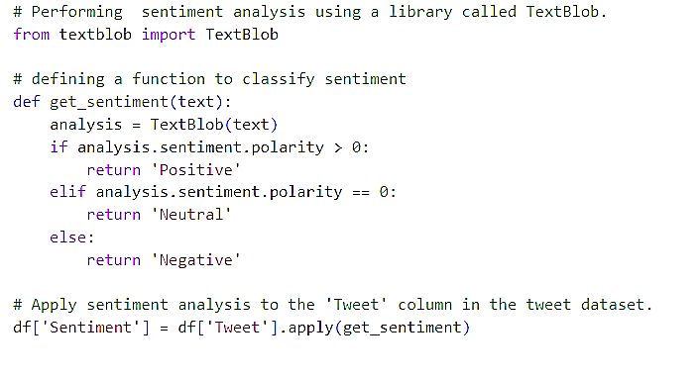
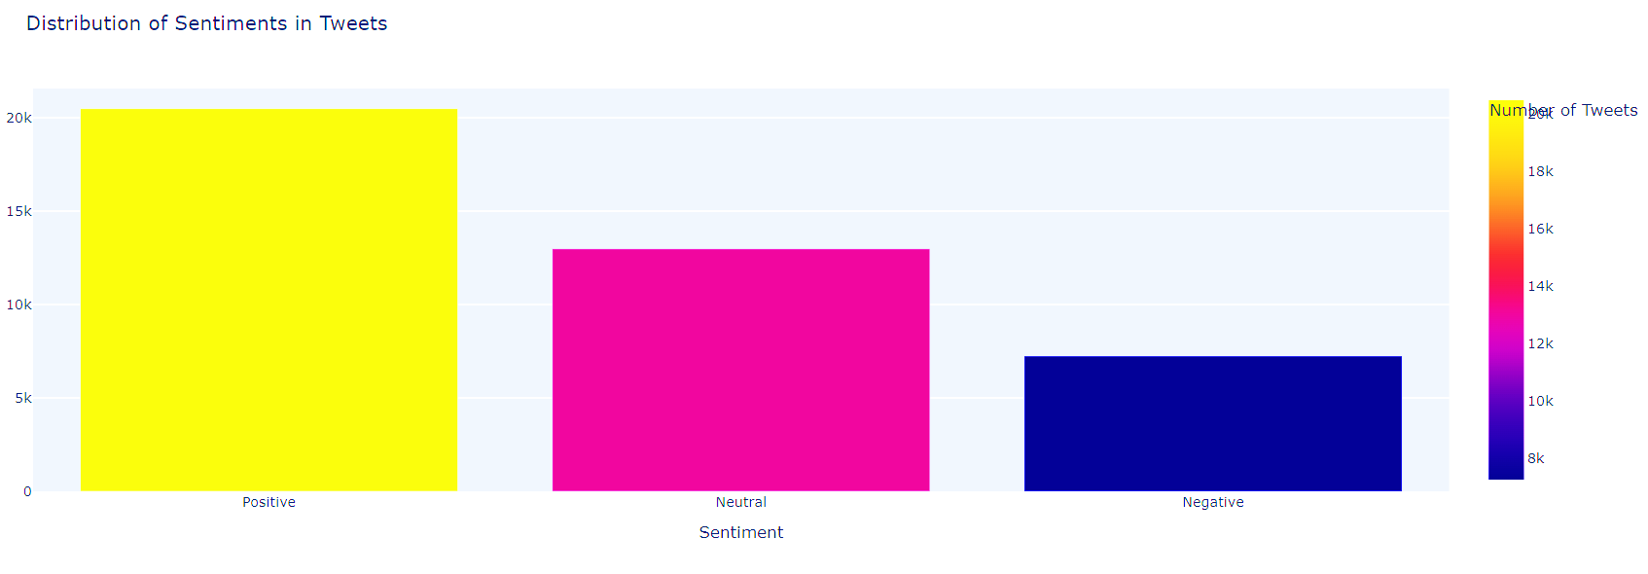
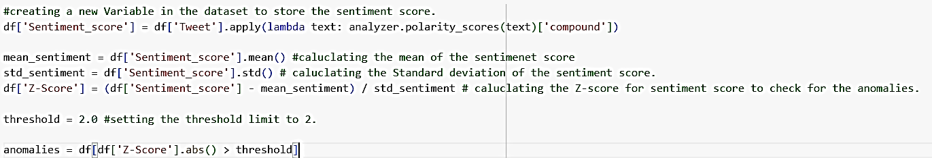
Sentiment Analysis
TextBlob is utilized to analyze sentiments in a 'Tweet' column, creating a 'Sentiment' column for effective Positive, Neutral, or Negative classification.
The Twitter dataset reveals a significant bias with a strong pattern of positive tweets (20,000-22,000), substantial neutral tweets (13,000-15,000), and negative tweets (5,000-8,000), emphasizing the need for bias-mitigating techniques in future studies and categorization models.
The dataset uses Vader sentiment analyzer's 'Sentiment_score' variable to detect and address outliers in sentiment scores, enhancing data quality through Z-scores with a 2.0 threshold.

Slide 6
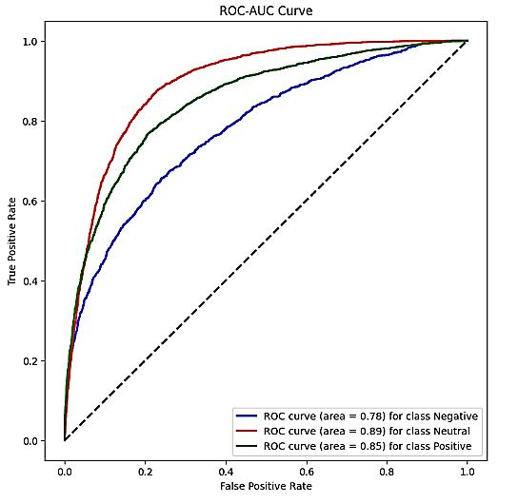
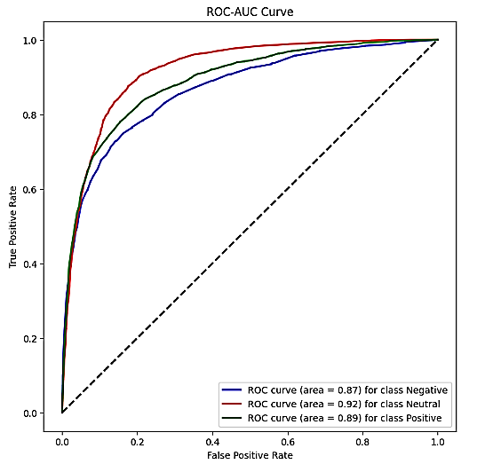
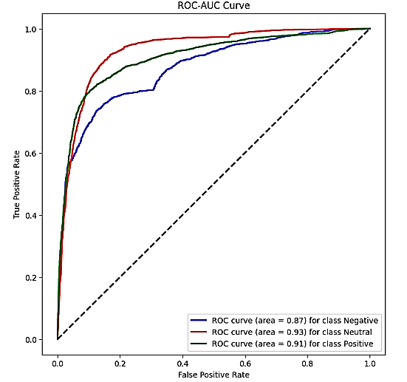
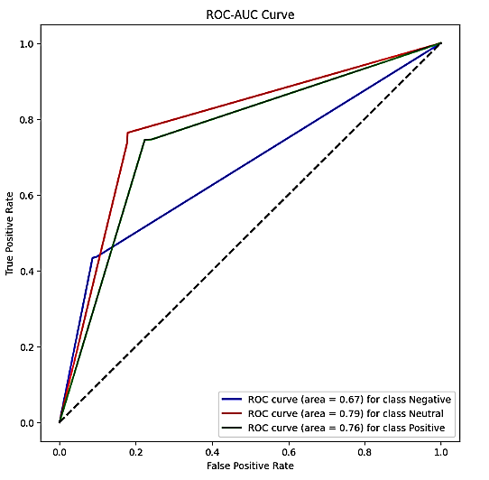
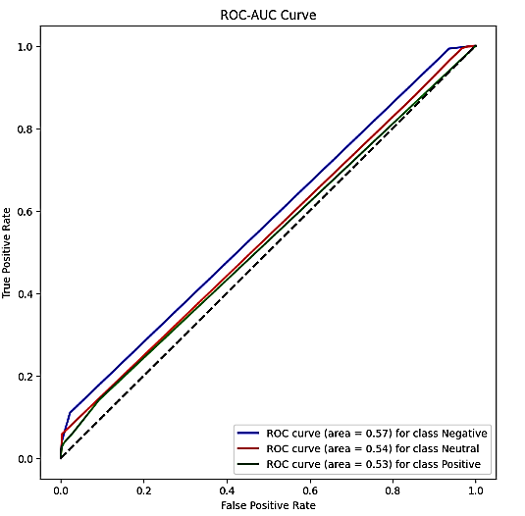
Classification Model for tweets
Multinominal Naïve Bayes Classifier
Random forest Classifier
SVM Classifier
Decision Tree Classifier
KNN Classifier

Slide 7
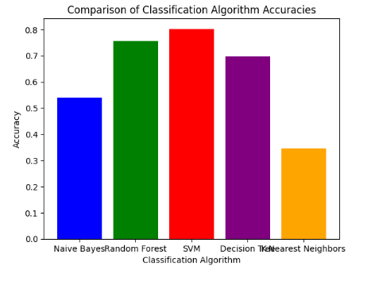
Evaluation
Performance metrices of text classification model

Slide 8
Migrating of Sentiment Data and Historical Stock Data
01
02
03
Preprocessing of stock Data
Preprocessing of merged data
Combining the data
Preprocessing of merged data like deleting the duplicate rows, label encoding, scaling the data, removing the outliers.
Using an inner join, the dataset was migrated with simplicity, aligning entries according to the shared 'Date' and 'Stock Name' columns between the two datasets.
Stock data preprocessing involved converting date columns to standardized format, refining the dataset by selecting specific stock names, and ensuring uniformity in temporal representation.

Slide 9
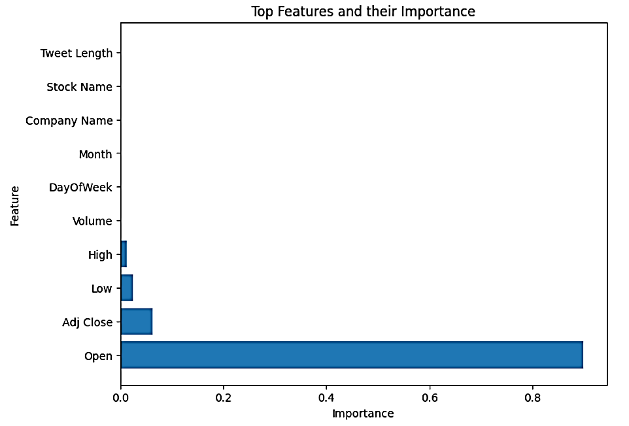
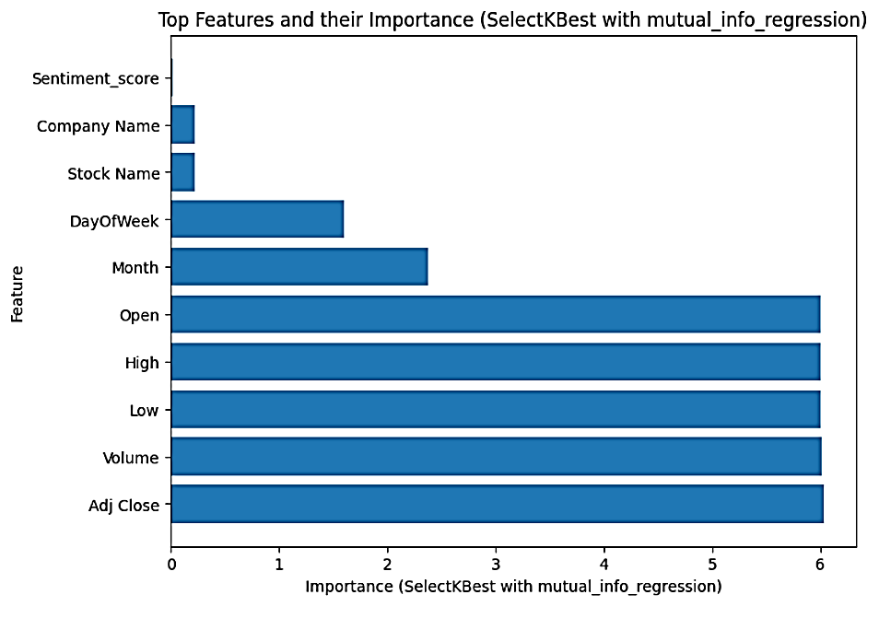
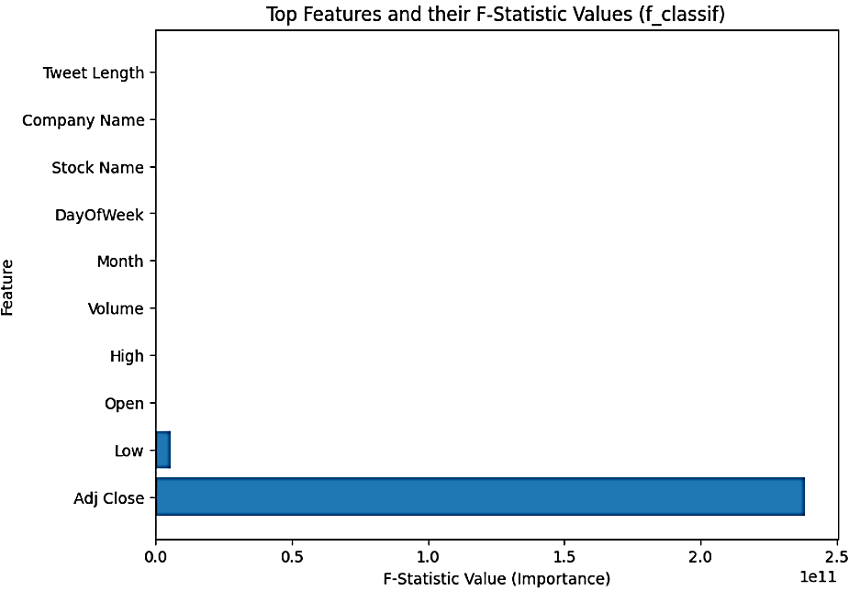
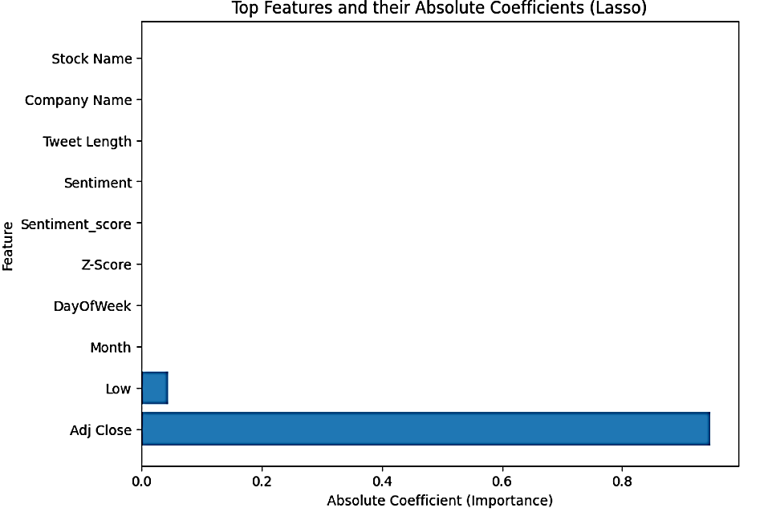
Feature Selection
Random Forest with RFE
Mutual info Regressor
Kbest with F_classif
Lasso

Slide 10
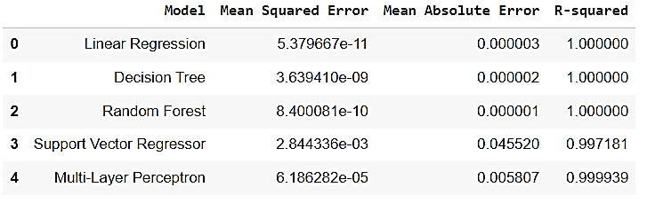
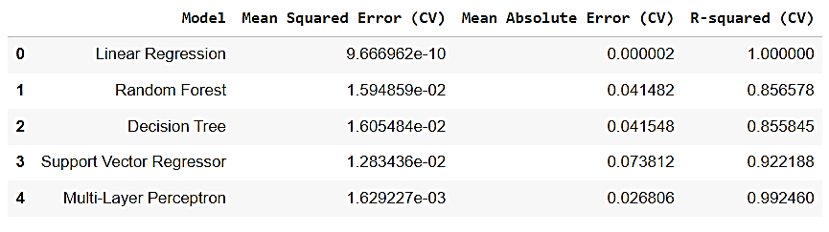
Model with and without Cross Validtaion Technique
Model Building without cross Validation Technique
Model Building with Cross Validation Technique

Slide 11
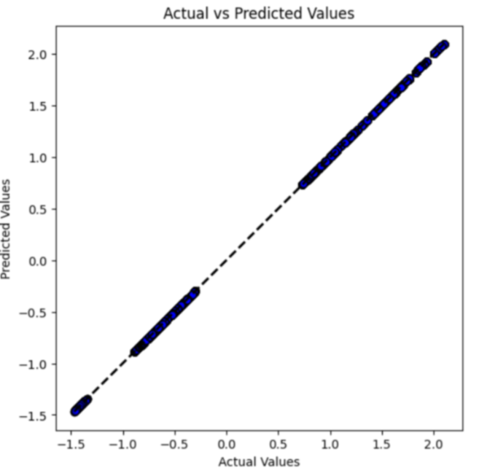
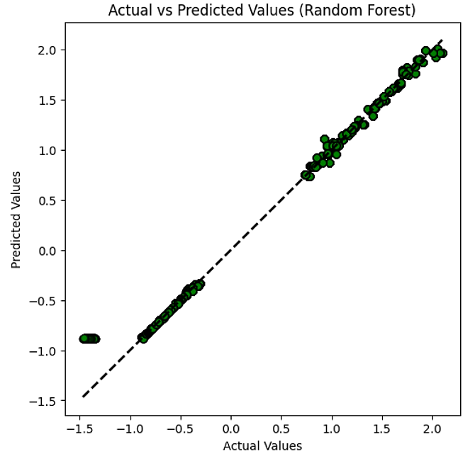
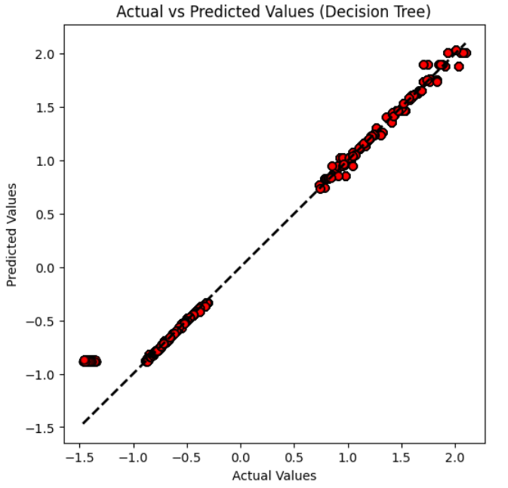
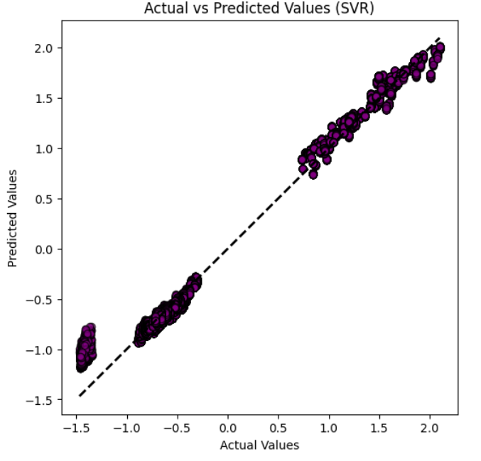
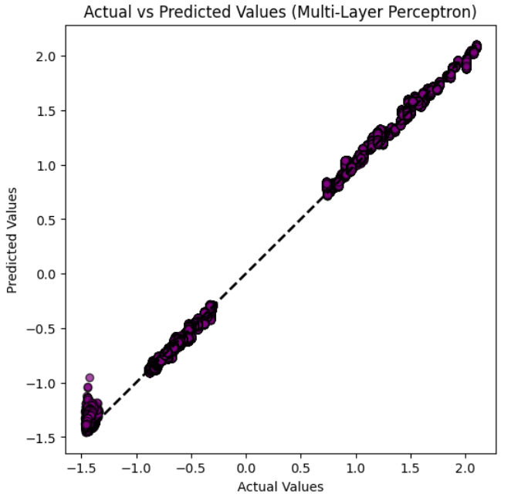
Linear Regression Model
Random Forest Model
Decision Tree Model
SVR Model
Multi Layer Perceptron Model

Slide 12
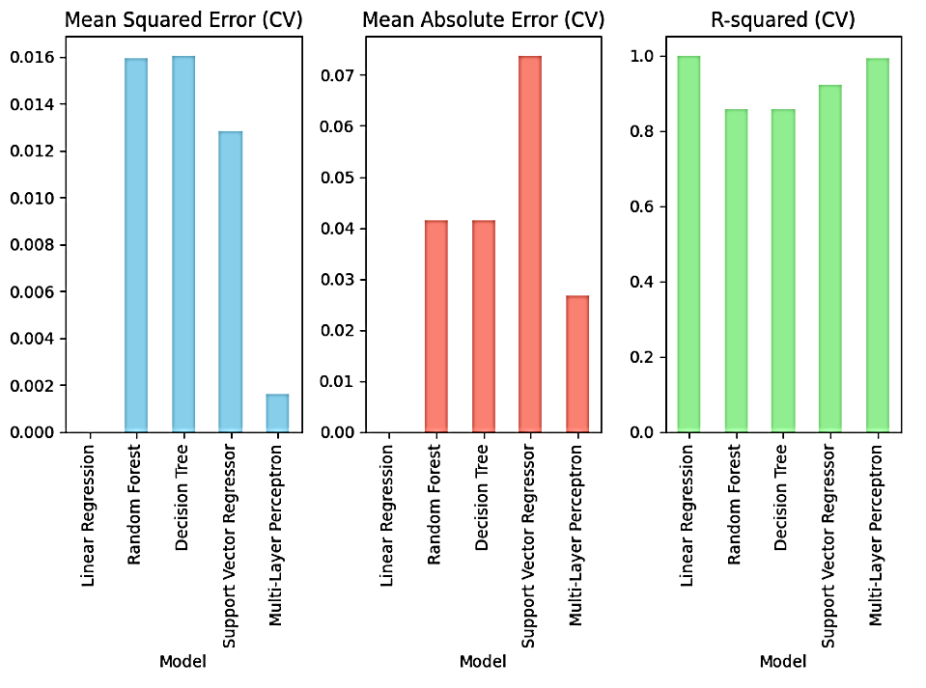
Evaluation
Performance metrices of the models

Slide 13
Conclusion
TextBlob and Vader Sentiment both performed well for computing sentiment scores and conducting sentiment analysis on tweets.
The Mutual Information Regressor proved to be an effective method for selecting features, emphasizing sentiment score as an essential predictor of stock prices.
Using sentiment data and historical stock data, the Random Forest Regressor model is the preferred choice for stock price prediction.
The Random Forest Regressor is a strong option in this situation because of its capacity to reduce overfitting and improve generalization across a variety of datasets.
Impact
By combining these approaches, sentiment-based stock price forecasts become more accurate and reliable, providing a more knowledgeable basis for financial analysis and decision-making for Investors and Traders, Financial Analysts, Business Executives and many more stake holders in finance.
Limitations
Concern about overfitting.
Data Source Limitation.
Model Dependency.
External Factors.
Dynamic Nature of Stock Market.

